Slide 1
TOPIC: ENTERTAINMENT

Slide 2
1
Most: hầu hết
/məʊst/
The kids loved the fair, but they enjoyed the bumper cars most of all.

Slide 3

2
Tend to: có xu hướng
/tend/
Nurses tended to the injured.

Slide 4

3
Mass media industry: công nghiệp truyền thông đại trà
/mæs ˈmiː.di.ə ˈɪn.də.stri/
Mass media industry is very popular in our country

Slide 5

5
Grab out attention: thu hút sự chú ý
/ɡræb aʊt əˈten.ʃən/
That hat caught everyone's attention

Slide 6
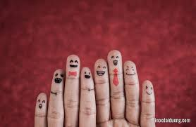
6
Interested: thú vị
/ˈɪn.trə.stɪd/
That girl looks very interesting

Slide 7
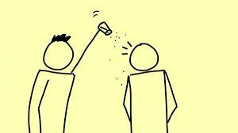
7
Bored: tẻ nhạt
/bɔːd/
It was a cold, wet day and the kids were bored.

Slide 8
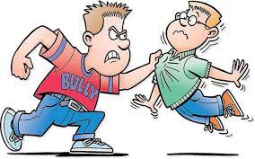
8
Violence: bạo lực
/ˈvaɪə.ləns/
I really hate people who like to use violence

Slide 9
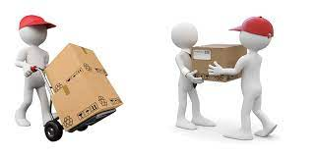
9
Distribution: phân phát
/ˌdɪs.trɪˈbjuː.ʃən/
a map showing distribution of global population

Slide 10
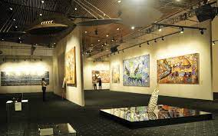
10
Exhibition: cuộc triển lãm, trưng bày
/ˌek.sɪˈbɪʃ.ən/
The pictures in the exhibitions are all very beautiful

Slide 11
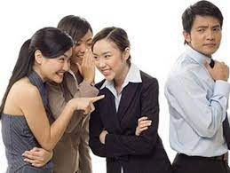
11
Gossip: bàn tán, buôn dưa lê, tin đồn nhảm
/ˈɡɒs.ɪp/
Her letter was full of gossip.

